Slide 1

COMMUNICATION 1
Lesson 1: Customs around the world
Lesson 2: Tourist activities around the world

Slide 2
OBJECTIVES OF THE LESSONS
01
02
03
Tourist activities
Grammar
Some ways of greeting
04
05
Gestures
Talk about Vietnamese customs and gestures
Present perfect tense
Greeting
Exchanging business cards
Small talks

Slide 3
Lesson 2: Tourist activities around the world
Notes:
Vì topic nói đang nhúng vào customs nên được giảng sau phần lesson 2

Slide 4
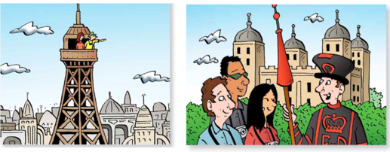
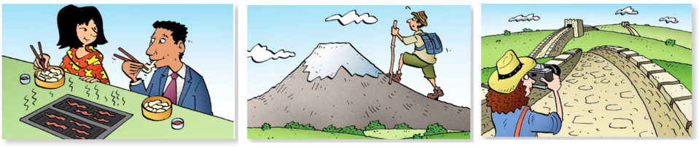
Group work: Match the activity with the picture - 2 minutes
Climb Fuji mountain
Take a tour of the tower of London
Go sightseeing in New York
Go to the top of the Eiffel tower
Try Korean food
Take pictures of the Great Wall
Go to the top of the Eiffel tower
Take a tour of the tower of London
Try Korean food
Climb Fuji mountain
Take pictures of Great Wall

Slide 5
02
GRAMMAR
Present perfect

Slide 6
Group work: Which sentences are present perfect or past simple?. 1 minutes
We lived in Japan from 1995 to 1998.
She has worked as a teacher since 2021.
I saw the Eiffel tower in 1997.
I have seen the Eiffel tower before.
He has already watched the movie three times.
Have you gone sightseeing in New York?
Past simple
Present perfect
Past simple
Present perfect
Present perfect
Present perfect

Slide 7
Group work: When do you use the present perfect tense? 2 minutes
Present perfect |  | Past simple
Examples | Usage | Examples | Usage
1. She has worked as a teacher since 2021. | Describe unfinished time | 1. We lived in Japan from 1995 to 1998. | Refer completed events in the past with specific time
2. I have seen the Eiffel tower before. | Refer indefinite time | 2. I saw the Eiffel tower in 1997.
3. He has already watched the movie three times. | Express experience or result
4. Have you gone sightseeing in New York? | Refer indefinite time

Slide 8
Group work: How does the present perfect form?
She has worked as a teacher since 2021.
I have seen the Eiffel tower before.
He has already watched the movie three times.
Have you gone sightseeing in New York?
+
S
have/ has
Past participle / V3
-
S
have/ has
not
Past participle / V3
?
Have/ Has
S
Past participle / V3?
?
WH
have/ has
S
Past participle / V3?

Slide 9
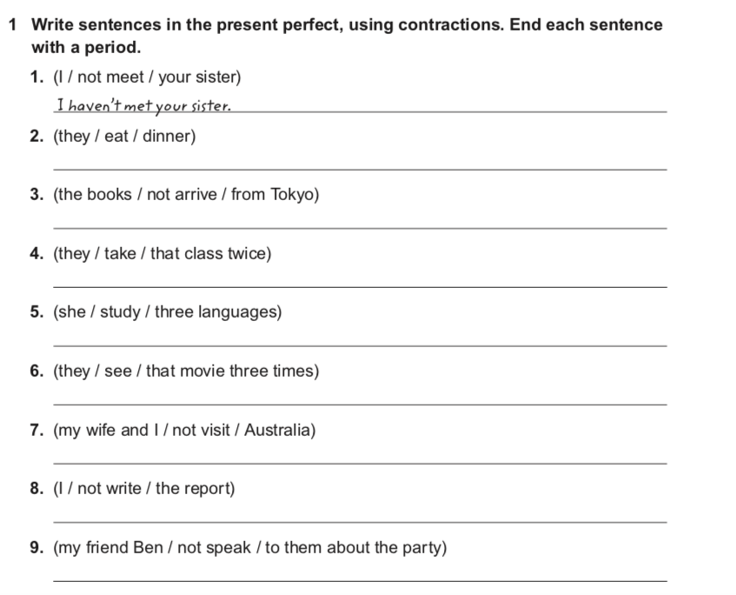
Group work - 5 minutes
They have eaten dinner.
The books haven’t arrived from Tokyo.
They have taken that class twice.
She has studied three languages.
They have seen that movie three times.
My wife and I haven’t visited Australia.
I haven’t written the report.
My friend Ben hasn’t spoken to them about the party.

Slide 10
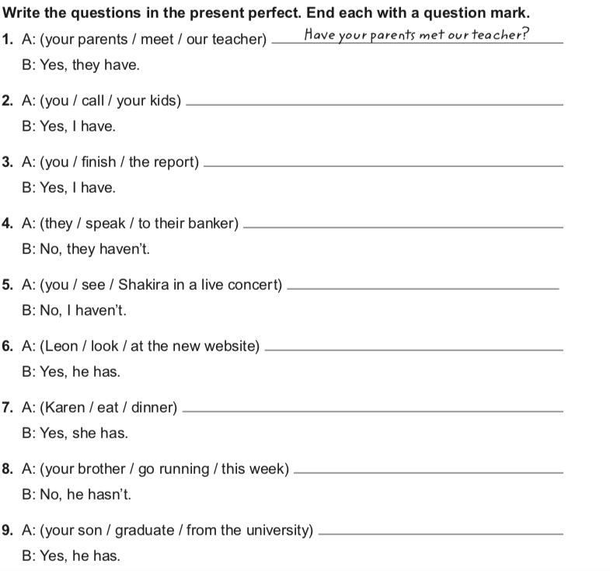
Pair work - 5 minutes
Have you called your kids?
Have you finished the report?
Have they spoken to their banker?
Have you seen Shakira in a live concert?
Has Leon looked at the new website?
Has Karen eaten dinner?
Has your brother gone running this week?
Has your son graduated from the university?

Slide 11
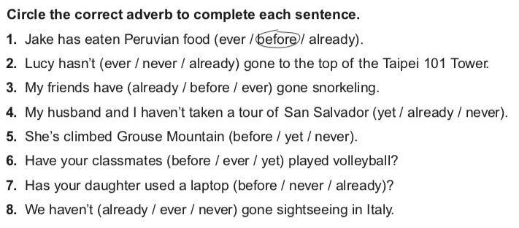
Adverbs in present perfect tense Pair work – 2 minutes

Slide 12
Pair work: What activities have you done? What activities haven’t you done? Use vocabulary and present perfect. 2 minutes
I have tried Korean food, but I haven’t climbed Fuji mountain.
I have taken a picture of Hoi An ancient town, but I haven't climbed Ba Den mountain.
Notes:
Modify hidden blanks from extra vocab by some tourist activities in Vietnam

Slide 13
Lesson1: Custom around the world

Slide 14
Lead - in
Watch the clip and answer the questions below

Slide 15
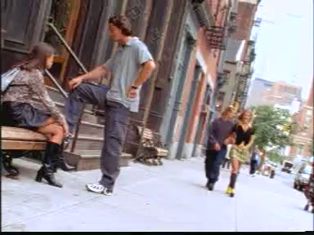
Notes:
https://www.youtube.com/watch?v=-DqGaDEYbGo
Teacher ask students to look at the board.

Slide 16
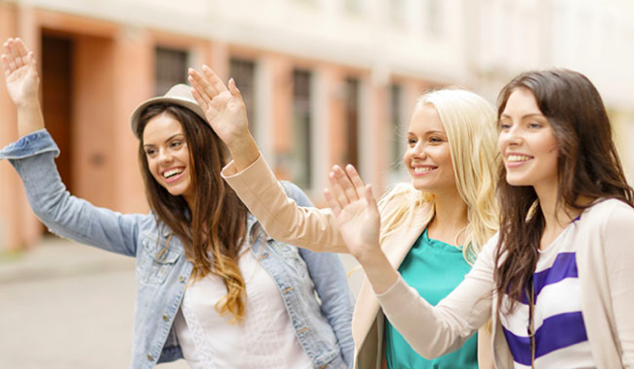
What is the clip about?
different ways of eating
different ways of boxing
different ways of greeting

Slide 17
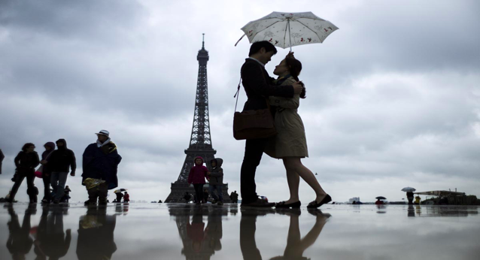
How do the French often greet each other?
kiss and hug
wave, smile and say hello
all are correct

Slide 18
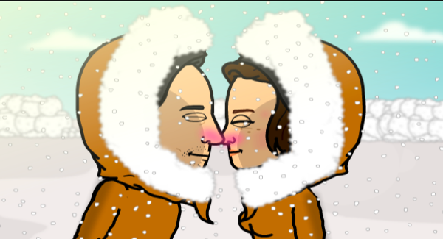
What is an Eskimo kiss?
the rubbing of two noses together
the rubbing of two foreheads together
the rubbing of two palms together

Slide 19
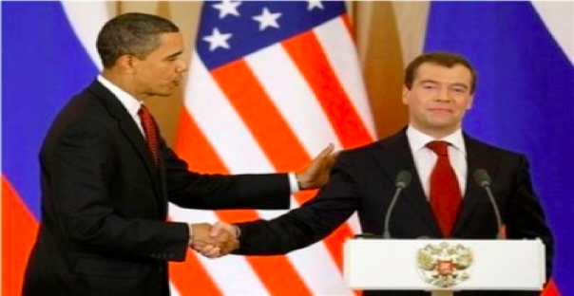
People shake hands to say hello and a pat on the shoulder is a sign of…
a. friendship
b. love
c. war

Slide 20
01
Greetings

Slide 21
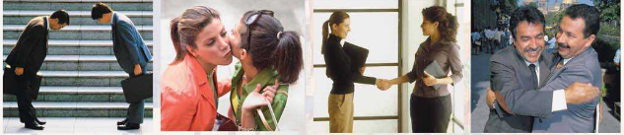
Group work: Answer the questions - 2 minutes
1. How do people greet each other? (Look at the picture)
2. What are other ways for greeting?

Slide 22
Group work: - TALK ABOUT GREETING IN VIET NAM (10 minutes)
What are some greeting ways in VN?
Eg. Well, some greeting ways in Vietnam are ………..
2. How do you greet elderly people / young people / your friends?
Eg. I greet elderly people by ………………………………………….
I greet young people by………………………………………….
3. Do you usually shake hands when you meet someone?
Eg. I would say that I shake hand when I meet my ……………………………
4. Do you prefer light or firm handshakes? Why do you like that style?
Eg. Honestly, I prefer …………………………… because………………………
Useful language
Nod
Hug
Wave hand
Pat on shoulder
Say hello
Warm
Polite
Impolite
Rude
Aggressive

Slide 23
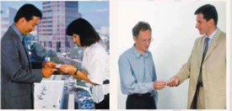
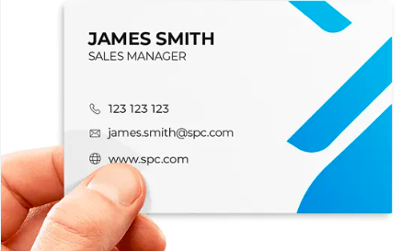
Exchanging business cards
Pair work -Read and answer the questions - 5 minutes
What are they doing?
E.g. I think they are ………………………………….
2. What information could you see on a business card?
E.g. Well, the information I could see on a business card is …………

Slide 24
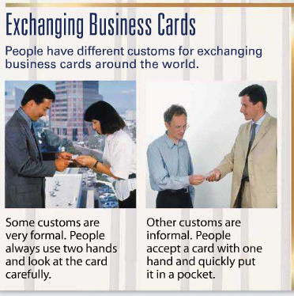
Exchanging business cards
Pair work -Read and answer the questions - 5 minutes
How many ways of exchanging business cards? What are they?
E.g. Well, there are ………………………………….. They are ………
2. How do Vietnamese people exchange business cards?
E.g. People accept a business card with ………………………..
3. How do you give your business card?
E.g. I give my business card with …………………………………
4. How do you take business cards from others?
E.g. I take business cards from others with ……………………..

Slide 25
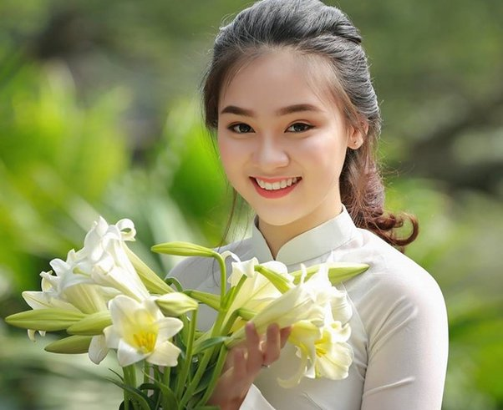
Small talks
Group work - 2 minutes
What should you talk to a pretty girl when you first meet her?
Useful language
Salary
Age
Weather
Hobby
Politics
Religion
Family
Job

Slide 26
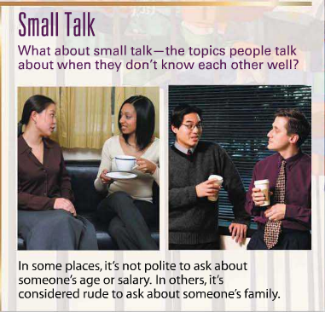
Small talks
Pair work -Read and answer the questions - 2 minutes
.
Is it polite to ask about someone's age or salary according to the passage?
----------------------------------------------------------------------------------
2. What are the topics Vietnamese people usually have for small talks?
E.g. Let’s see. The topics Vietnamese people have for small talks are ……………………………………………………………………………
3. What are the topics that you should avoid for small talks?
E.g. For me, the topics I should avoid for small talks are …………………………………………………………………………………

Slide 27
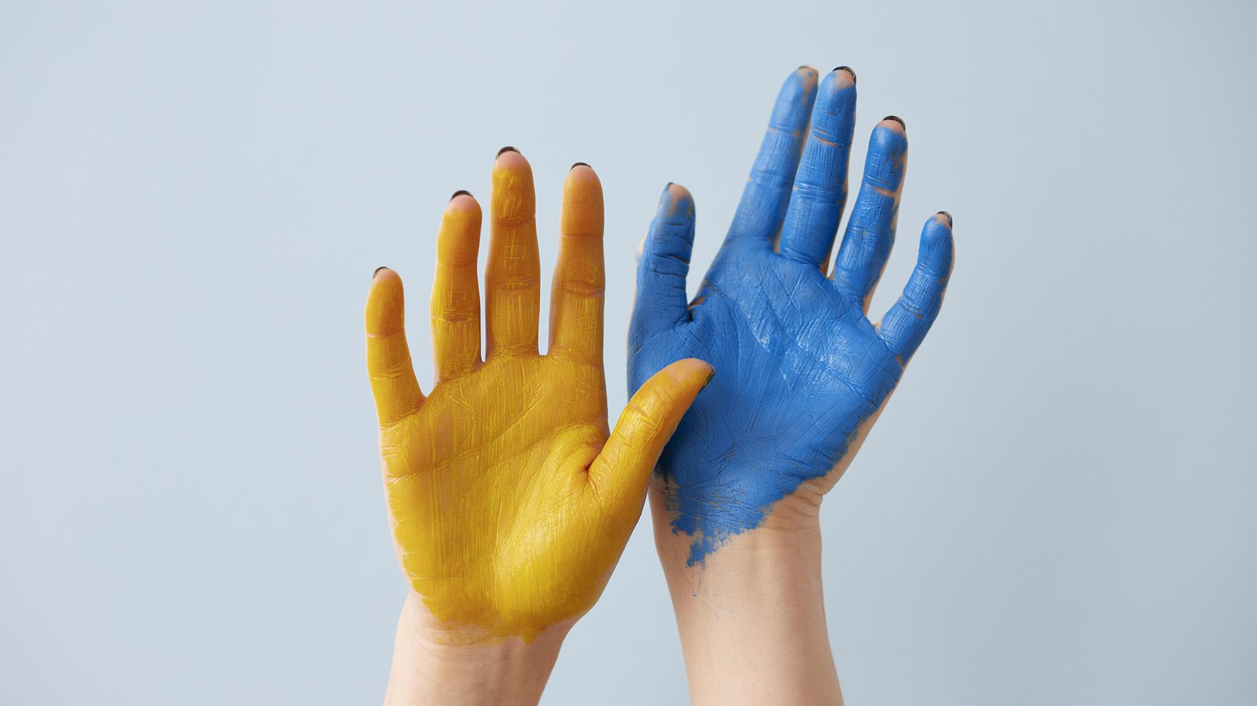
02
Gestures

Slide 28
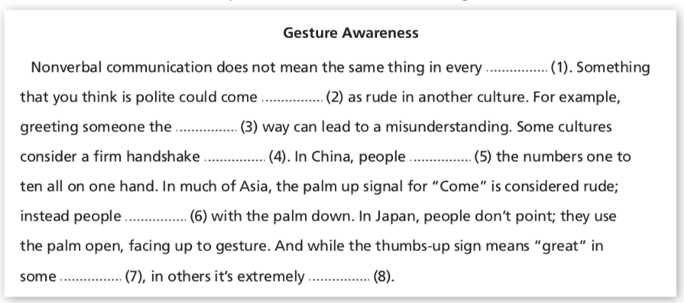
Choose the correct word to complete the sentences in the reading.
country
across
wrong
aggressive
indicate
gesture
cultures
rude

Slide 29
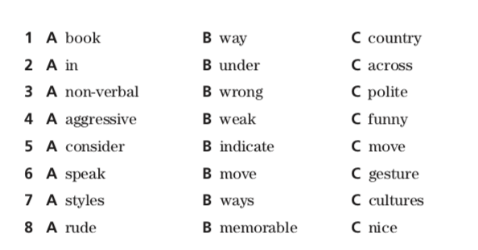

Slide 30
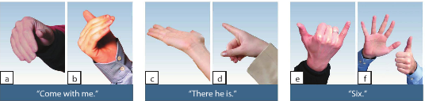
Group work. Discuss the questions - 5 minutes
Do gestures have different meanings in different countries?
What are some gestures you know in Vietnam?
E.g. Some gestures I know are …………………………………………………………………………………………………
3. What does the thumbs-up sign means in Vietnam?
E.g. The thumbs-up sign means ……………………………………………………………………………………………
4. In Vietnam, how do you point at someone?
E.g. In Vietnam, when we point at someone, we usually ……………………………………………………………………
Useful language
Palm up
Palm down
Thumbs- up
Ok sign

Slide 31
What have we learned today?
CONSOLIDATION
1. Tourist activities
2. Grammar
Present perfect tense
3. Some ways of greeting
Greeting
Exchanging business cards
Small talk
4. Gestures
5. Talk about Vietnamese customs and gestures

Slide 32
Topic 1
Talk about your Vietnamese gestures and customs

Slide 33
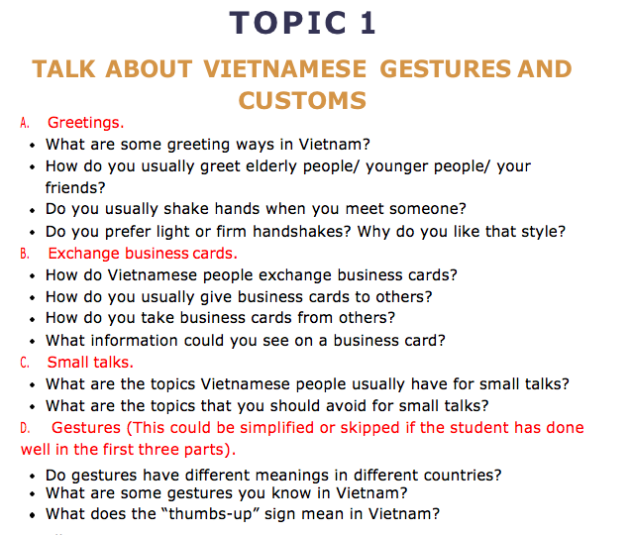

Slide 34
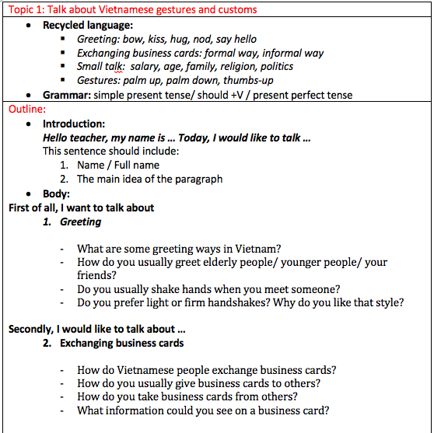
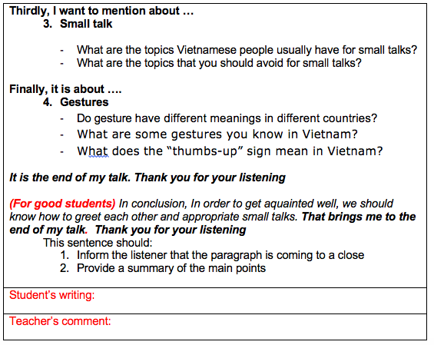
Writing format

Slide 35


